Slide 1


Jano Esterhuizen
02/02/2025

Slide 2

Outline
Executive Summary
Introduction
Methodology
Results
Conclusion
Appendix

Slide 3
Executive Summary
The goal of this research is to analyze SpaceX Falcon 9 data collected through various sources and employ Machine Learning models to predict the success of first stage landing that provides other space agencies the ability to decide if they bid against SpaceX.
• Summary of methodologies
• Following concepts and methods were used to collect and analyze data, build and evaluate machine learning models, and make predictions:
• Collect data through API and Web scraping
• Transform data through data wrangling
• Conduct exploratory data analysis with SQL and data visuals
• Build an interactive map with folium to analyze launch site proximity
• Build a dashboard to analyze launch records interactively with Plotly Dash
• Finally, build a predictive model to predict if the first stage of Falcon 9 will land successfully
• Summary of all results
• This report will share results in various formats such as:
• Data analysis results
• Data visuals, interactive dashboards
• Predictive model analysis results

Slide 4
Introduction
• Project background and context
• With the recent successes in private space travel, space industry is becoming more and more mainstream and accessible to general population. Cost of launch continues to remain a key barrier for new competitors to enter the space race
• SpaceX with its first stage reuse capabilities offers a key advantage against its competitors. Each SpaceX launch costs around 62 million dollar and SpaceX can reuse stage 1 for future launches. This provides SpaceX a unique advantage where other competitors are spending around 165 mission plus for each launch
• Problems you want to find answers
• Determine if the first stage of SpaceX Falcon 9 will land successfully
• Impact of different parameters/variables on the landing outcomes (e.g., launch site, payload mass, booster version, etc.)
• Correlations between launch sites and success rates

Slide 5

Section 1

Slide 6
Methodology
Executive Summary
• Data collection methodology:
• SpaceX API
• Web scrap Falcon 9 and Falcon Heavy launch records from Wikipedia (link)
• Perform data wrangling
• Determined labels for training the supervised models by converting mission outcomes in to training labels (0-unsuccessful, 1-successful)
• Perform exploratory data analysis (EDA) using visualization and SQL
• Perform interactive visual analytics using Folium and Plotly Dash
• Perform predictive analysis using classification models
• Created a column for ‘class’; standardized and transformed data; train/test split data; find ⁶ best classification algorithm (Logistic regression, SVM, decision tree, & KNN) using test data

Slide 7
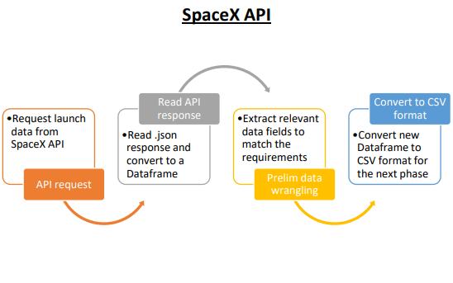
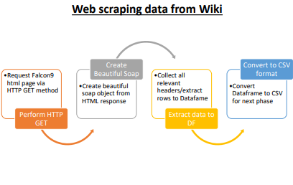
Data Collection
Data collection is the process of gathering data from available sources. This data can be structured, unstructured, or semi-structured. For this project, data was collected via SpaceX API and Web scrapping Wiki pages for relevant launch data.

Slide 8
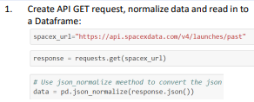
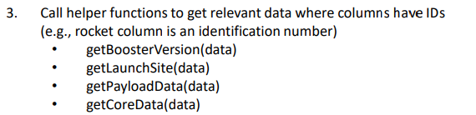
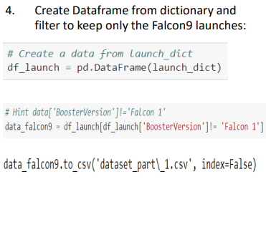
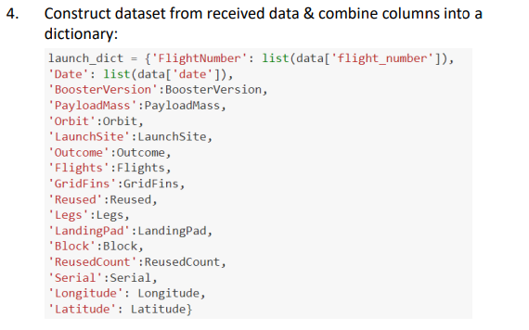
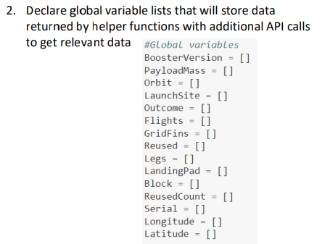
Data Collection – SpaceX API

Slide 9
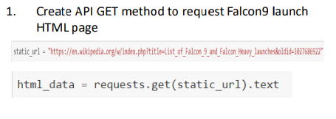
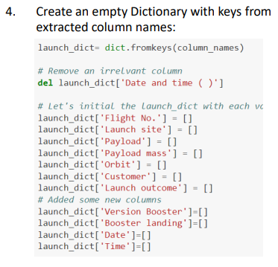
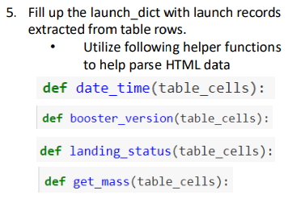
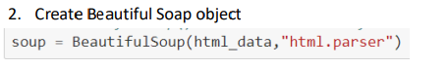
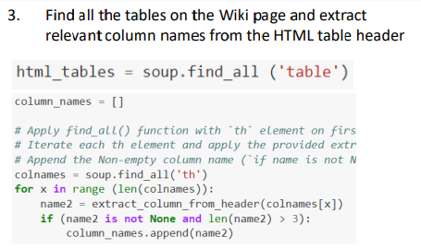
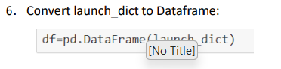
Data Collection - Scraping

Slide 10
Data Wrangling
• Conducted Exploratory Data Analysis (EDA) to find patters in data and define labels for training supervised models
• The data set contained various mission outcomes that were converted into Training Labels with 1 meaning the booster successfully landed and 0 meaning booster was unsuccessful in landing. Following landing scenarios were considered to create labels:
• True Ocean means the mission outcome was successfully landed to a specific region of the ocean
• False Ocean means the mission outcome was unsuccessfully landed to a specific region of the ocean
• RTLS means the mission outcome was successfully landed to a ground pad
• False RTLS means the mission outcome was unsuccessfully landed to a ground pad
• True ASDS means the mission outcome was successfully landed on a drone ship
• False ASDS means the mission outcome was unsuccessfully landed on a drone ship

Slide 11
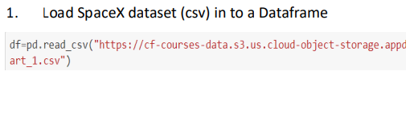
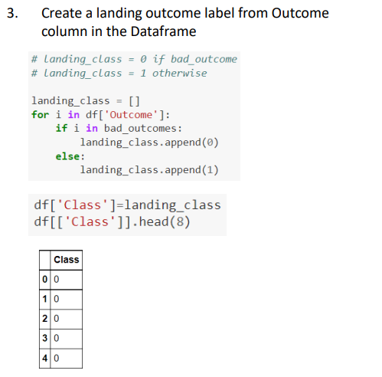
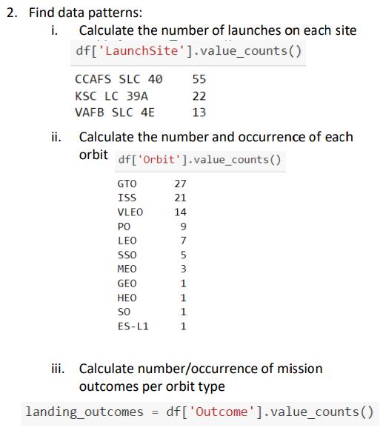
Data Wrangling

Slide 12
EDA with Data Visualization
• As part of the Exploratory Data Analysis (EDA), following charts were plotted to gain further insights into the dataset:
1. Scatter plot:
• Shows relationship or correlation between two variables making patterns easy to observe
• Plotted following charts to visualize:
• Relationship between Flight Number and Launch Site
• Relationship between Payload and Launch Site
• Relationship between Flight Number and Orbit Type
• Relationship between Payload and Orbit Type
2. Bar Chart:
• Commonly used to compare the values of a variable at a given point in time. Bar charts makes it easy to see which groups are highest/common and how other groups compare against each other. Length of each bar is proportional to the value of the items that it represents
• Plotted following Bar chart to visualize:
• Relationship between success rate of each orbit type
3. Line Chart:
• Commonly used to track changes over a period of time. It helps depict trends over time.
• Plotted following Line chart to observe:
• Average launch success yearly trend

Slide 13
EDA with SQL
• To better understand SpaceX data set, following SQL queries/operations were performed on an IBM DB2 cloud instance:
1. Display the names of the unique launch sites in the space mission
2. Display 5 records where launch sites begin with the string 'CCA’
3. Display the total payload mass carried by boosters launched by NASA (CRS)
4. Display average payload mass carried by booster version F9 v1.1
5. List the date when the first successful landing outcome in ground pad was achieved.
6. List the names of the boosters which have success in drone ship and have payload mass greater than 4000 but less than 6000
7. List the total number of successful and failure mission outcomes
8. List the names of the booster_versions which have carried the maximum payload mass. Use a subquery
9. List the failed landing_outcomes in drone ship, their booster versions, and launch site names for in year 201 5
10.Rank the count of landing outcomes (such as Failure (drone ship) or Success (ground pad)) between the date 2010-06-04 and 201 7-03-20, in descending order
13

Slide 14
Build an Interactive Map with Folium
• Folium interactive map helps analyze geospatial data to perform more interactive visual analytics and better understand factors such location and proximity of launch sites that impact launch success rate.
• Following map object were created and added to the map:
• Mark all launch sites on the map. This allowed to visually see the launch sites on the map.
• Added ‘folium.circle’ and ‘folium.marker’ to highlight circle area with a text label over each launch site.
• Added a ‘MarkerCluster()’ to show launch success (green) and failure (red) markers for each launch site.
• Calculated distances between a launch site to its proximities (e.g., coastline, railroad, highway, city)
• Added ‘MousePosition() to get coordinate for a mouse position over a point on the map
• Added ‘folium.Marker()’ to display distance (in KM) on the point on the map (e.g., coastline, railroad, highway, city)
• Added ‘folium.Polyline()’ to draw a line between the point on the map and the launch site
• Repeated steps above to add markers and draw lines between launch sites and proximities - coastline, railroad, highway, city)
• Building the Interactive Map with Folium helped answered following questions:
• Are launch sites in close proximity to railways? YES
• Are launch sites in close proximity to highways? YES
• Are launch sites in close proximity to coastline? YES
• Do launch sites keep certain distance away from cities? YES

Slide 15
Build a Dashboard with Plotly Dash
• Built a Plotly Dash web application to perform interactive visual analytics on SpaceX launch data in real-time. Added Launch Site Drop-down, Pie Chart, Payload range slide, and a Scatter chart to the Dashboard.
1. Added a Launch Site Drop-down Input component to the dashboard to provide an ability to filter Dashboard visual by all launch sites or a particular launch site
2. Added a Pie Chart to the Dashboard to show total success launches when ‘All Sites’ is selected and show success and failed counts when a particular site is selected
3. Added a Payload range slider to the Dashboard to easily select different payload ranges to identify visual patterns
4. Added a Scatter chart to observe how payload may be correlated with mission outcomes for selected site(s). The color-label Booster version on each scatter point provided missions outcomes with different boosters
• Dashboard helped answer following questions:
1. Which site has the largest successful launches? KSC LC-39A with 10
2. Which site has the highest launch success rate? KSC LC-39A with 76.9% success
3. Which payload range(s) has the highest launch success rate? 2000 - 5000 kg
4. Which payload range(s) has the lowest launch success rate? 0-2000 and 5500 - 7000
5. Which F9 Booster version (v1.0, v1.1, FT, B4, B5, etc.) has the highest launch success rate? FT

Slide 16
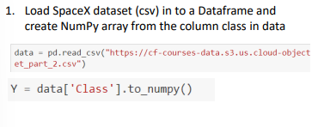
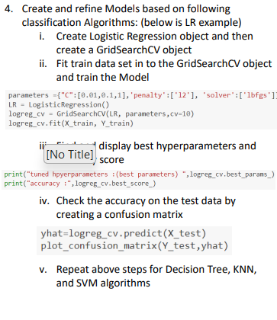
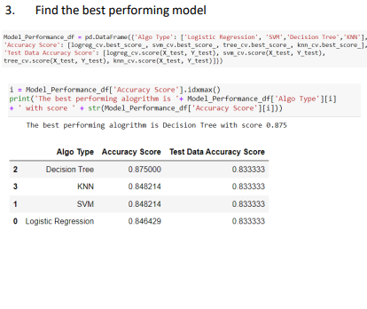
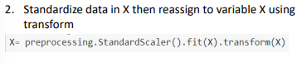
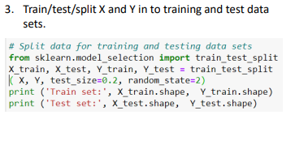
Predictive Analysis (Classification)

Slide 17
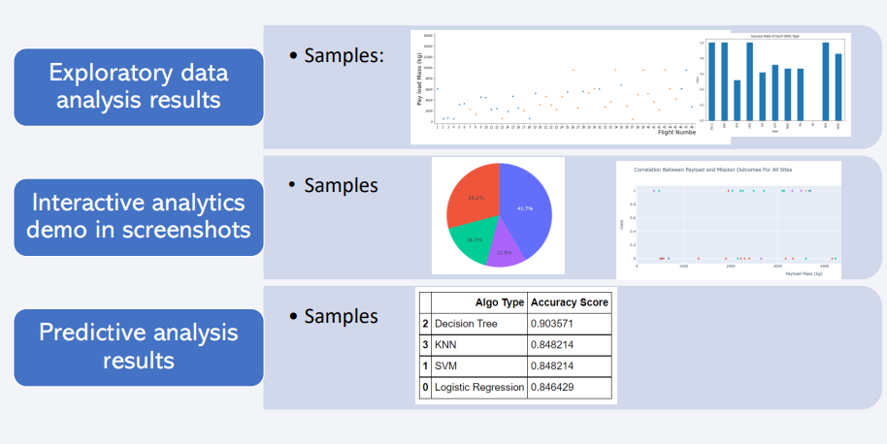
Results
Following sections and slides explain results for:

Slide 18

Section 2

Slide 19
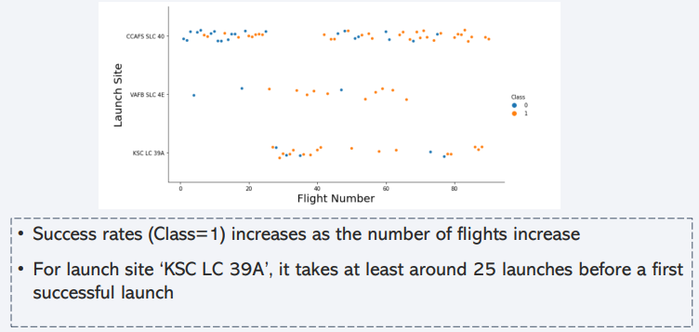
Flight Number vs. Launch Site

Slide 20
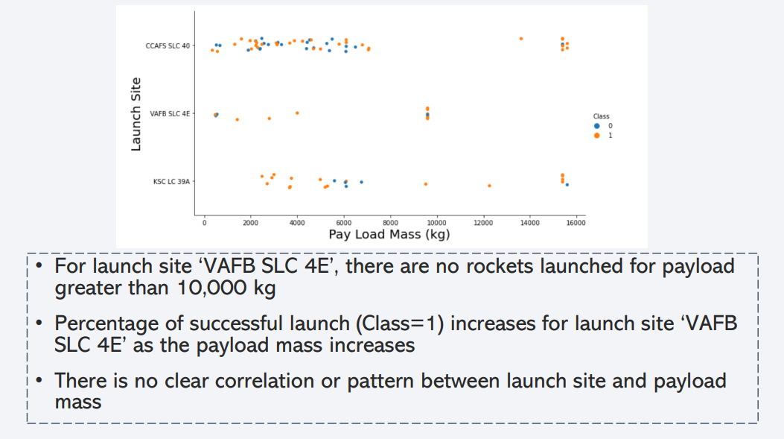
Payload vs. Launch Site

Slide 21
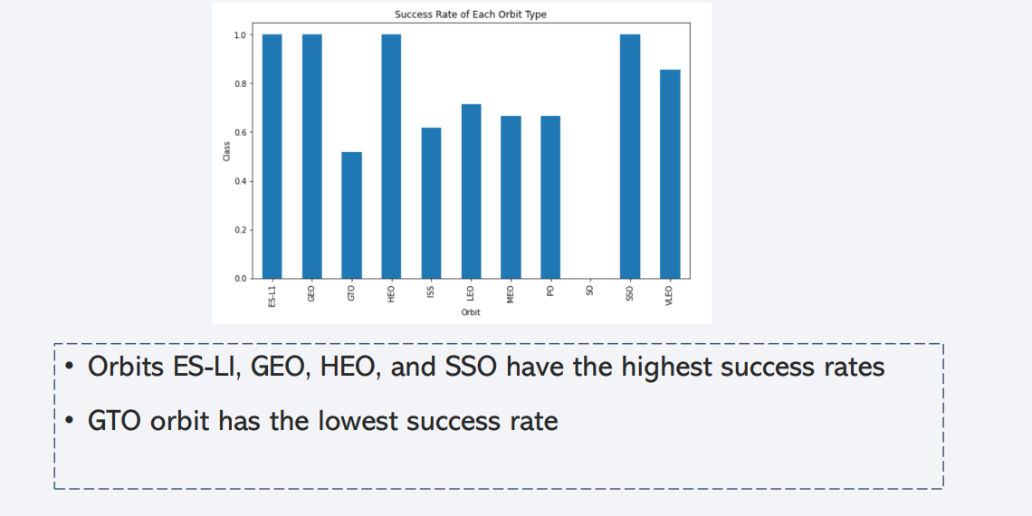
Success Rate vs. Orbit Type

Slide 22
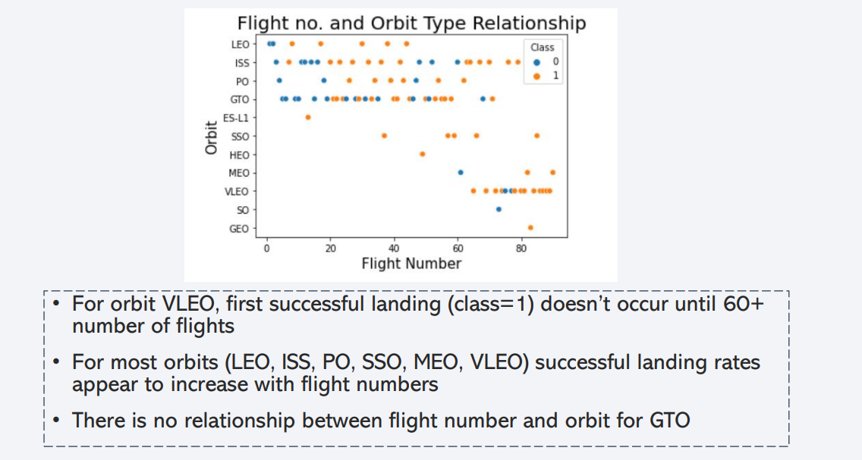
Flight Number vs. Orbit Type

Slide 23
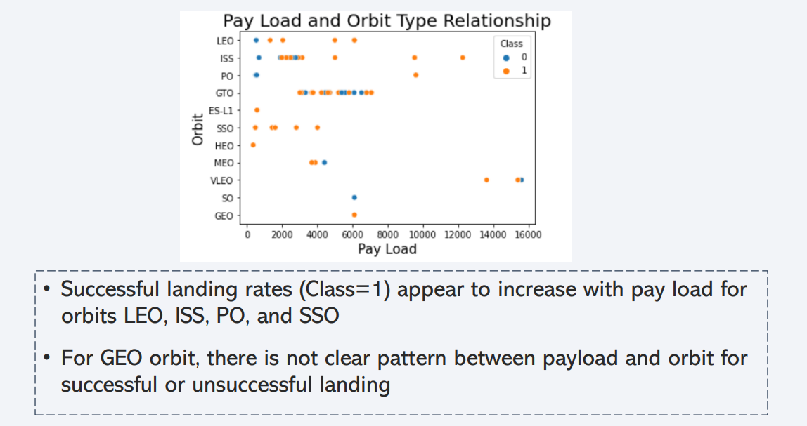
Payload vs. Orbit Type

Slide 24
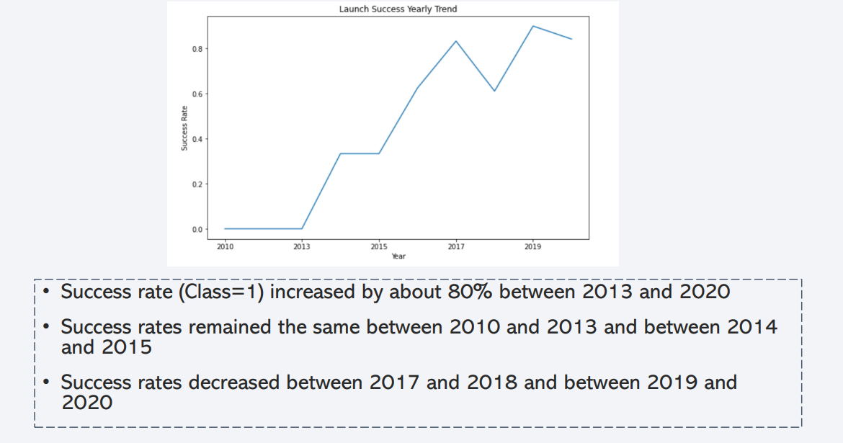
Launch Success Yearly Trend

Slide 25
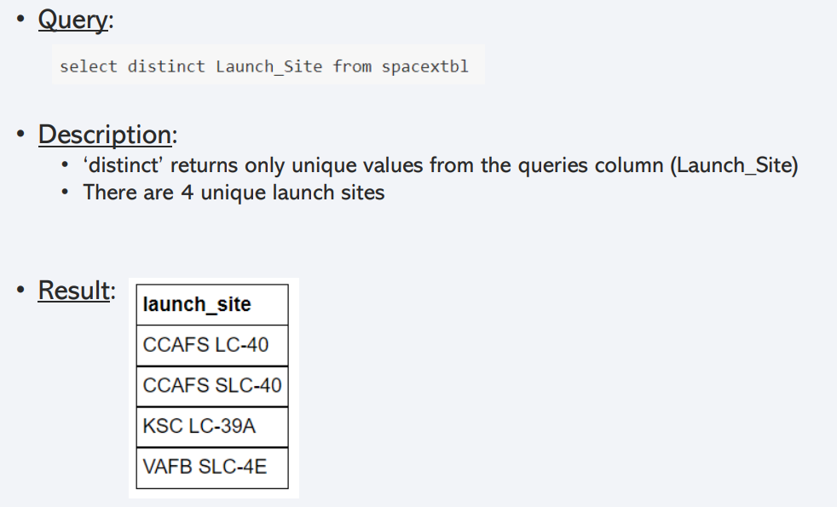
All Launch Site Names

Slide 26
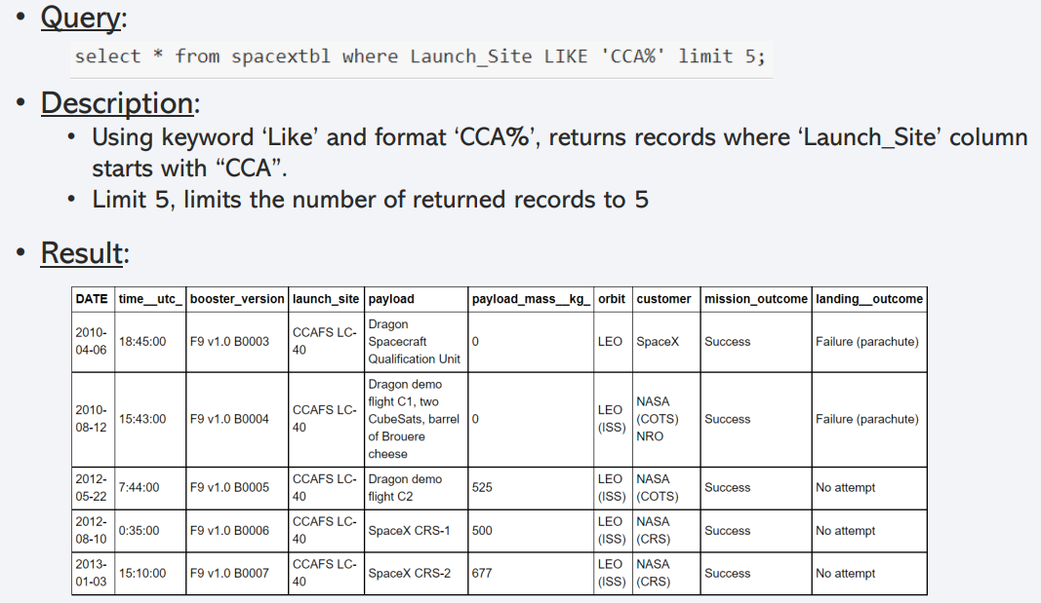
Launch Site Names Begin with 'CCA'

Slide 27
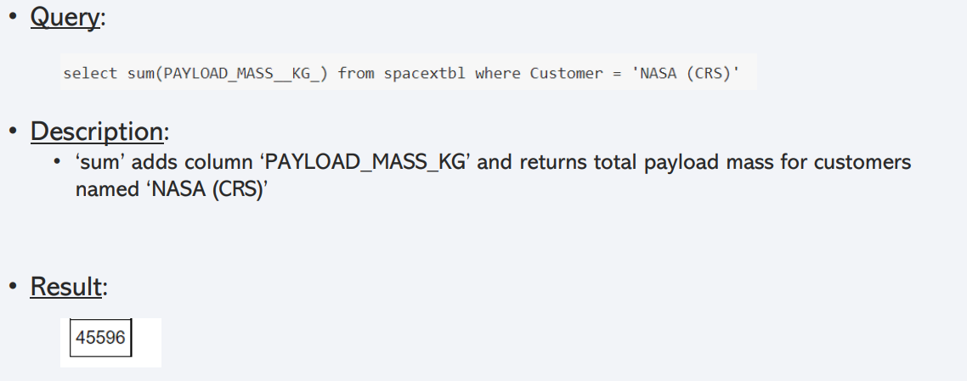
Total Payload Mass

Slide 28
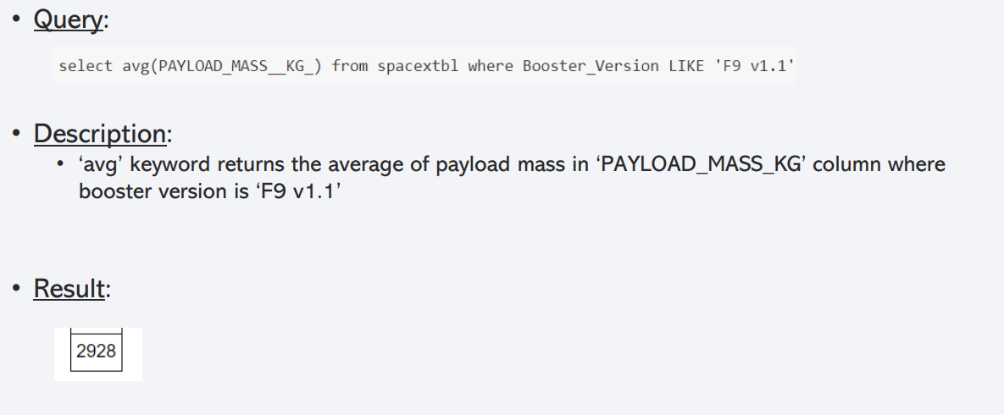
Average Payload Mass by F9 v1.1

Slide 29
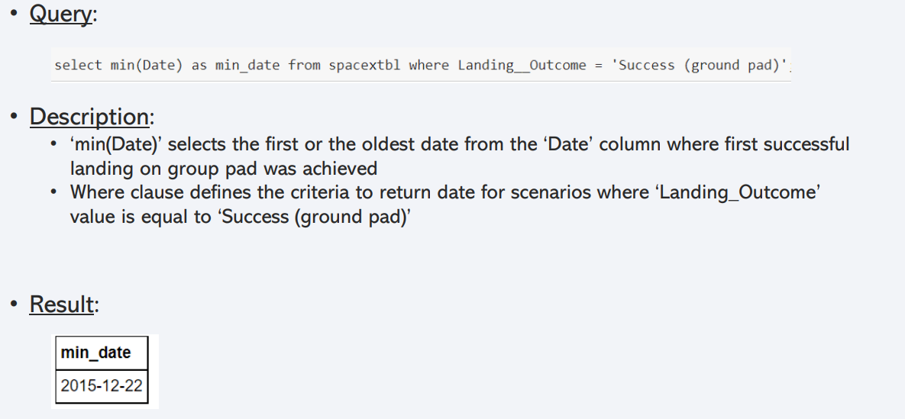
First Successful Ground Landing Date

Slide 30
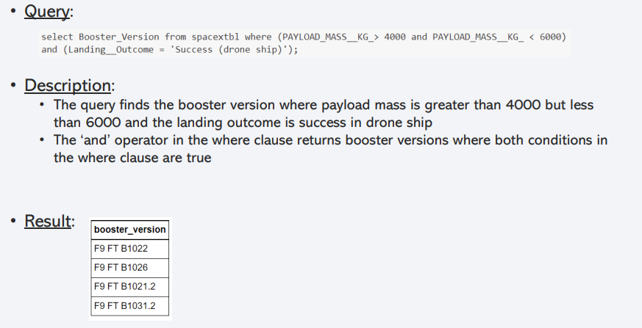
Successful Drone Ship Landing with Payload between 4000 and 6000

Slide 31
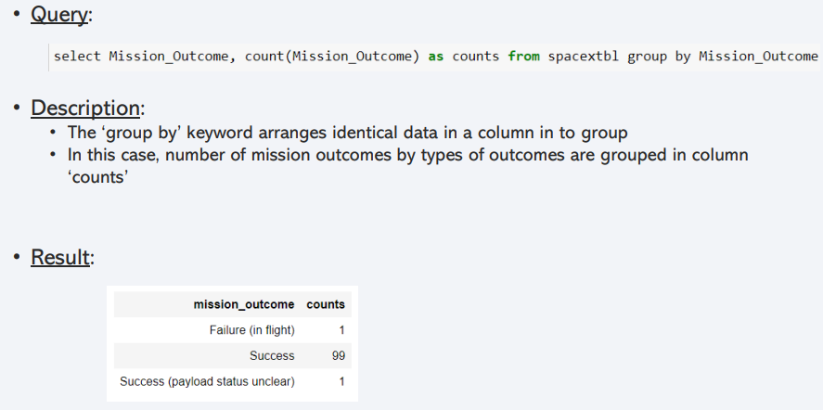
Total Number of Successful and Failure Mission Outcomes

Slide 32
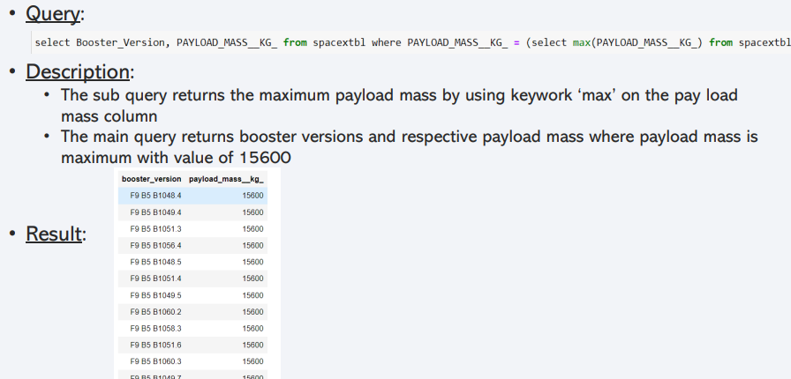
Boosters Carried Maximum Payload

Slide 33
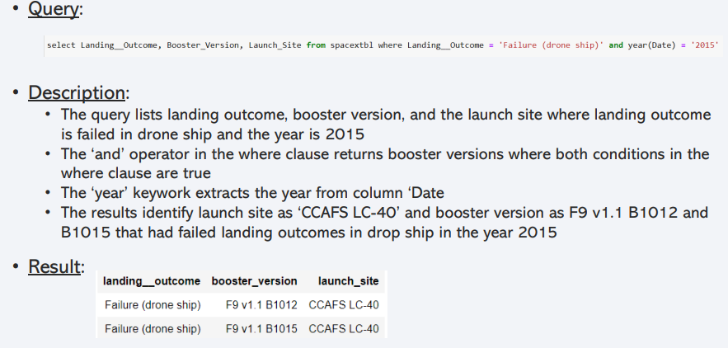
2015 Launch Records

Slide 34
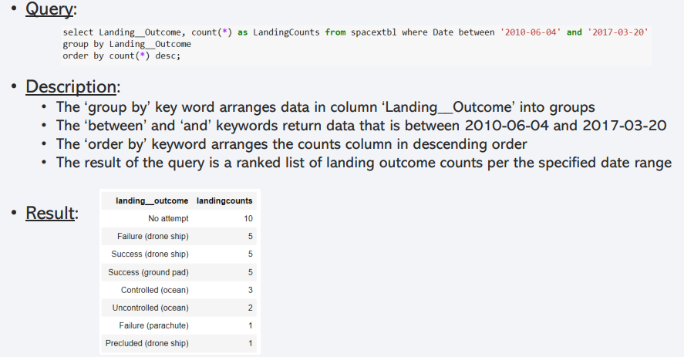
Rank Landing Outcomes Between 2010-06-04 and 2017-03-20

Slide 35

Section 3

Slide 36
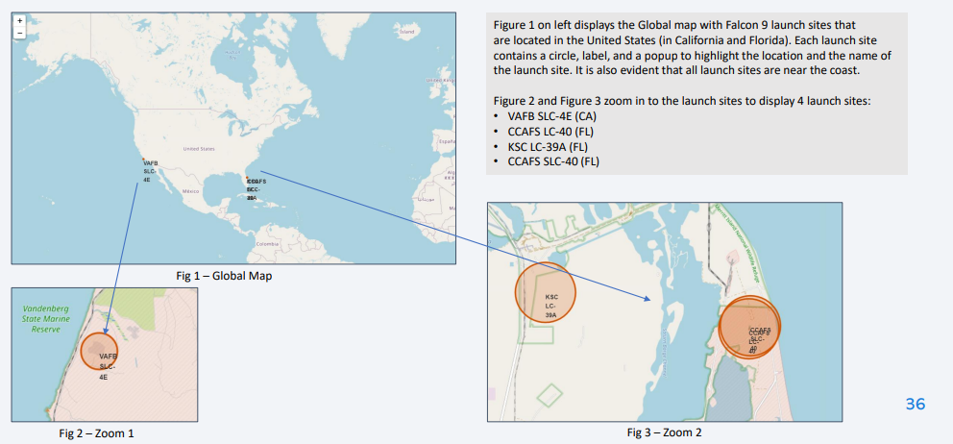
SpaceX Falcon9 - Launch Sites Map

Slide 37
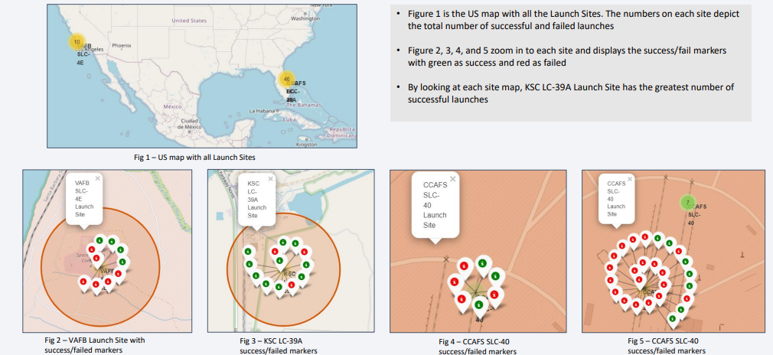
SpaceX Falon9 - Success/Failed

Slide 38
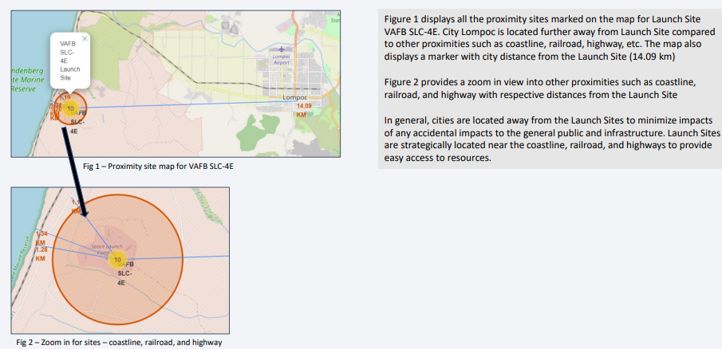
SpaceX Falon9 – Launch Site to Proximity Map

Slide 39

Section 4

Slide 40
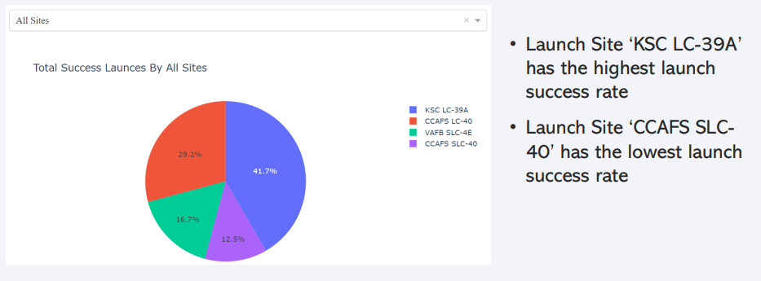
Launch Success Counts For All Sites

Slide 41
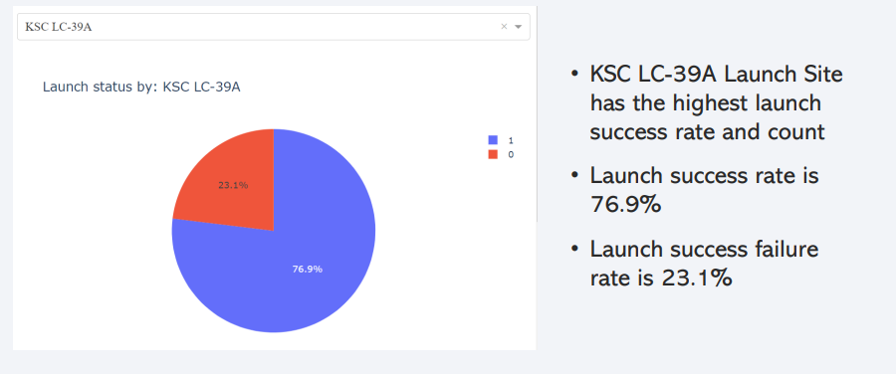
Launch Site with Highest Launch Success Ratio

Slide 42
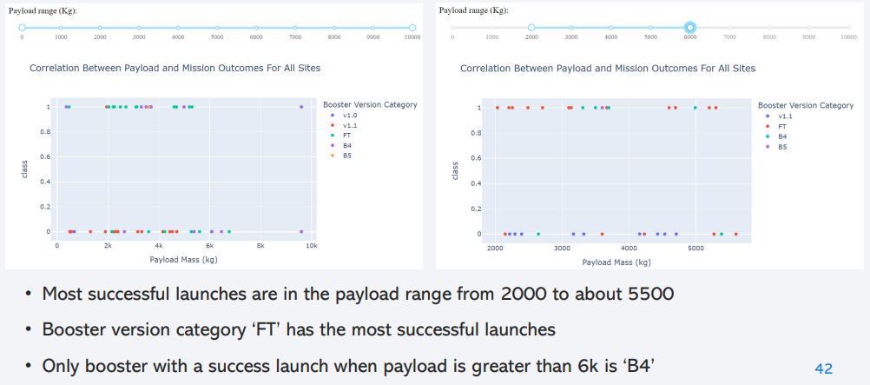
Payload vs. Launch Outcome Scatter Plot for All Sites

Slide 43

Section 5

Slide 44
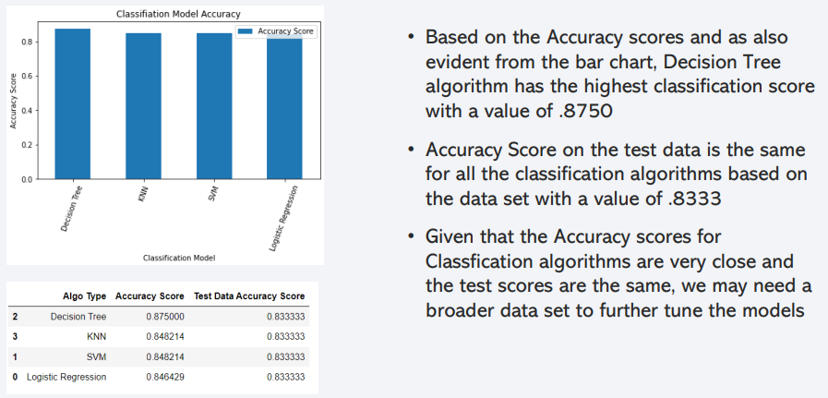
Classification Accuracy

Slide 45
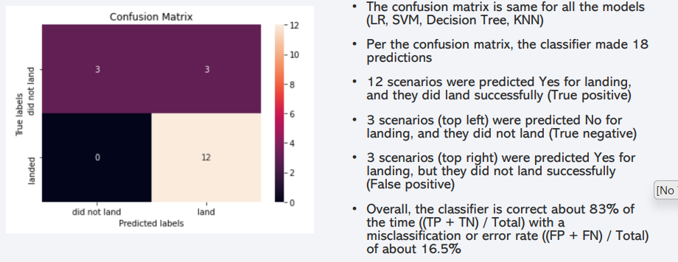
Confusion Matrix

Slide 46
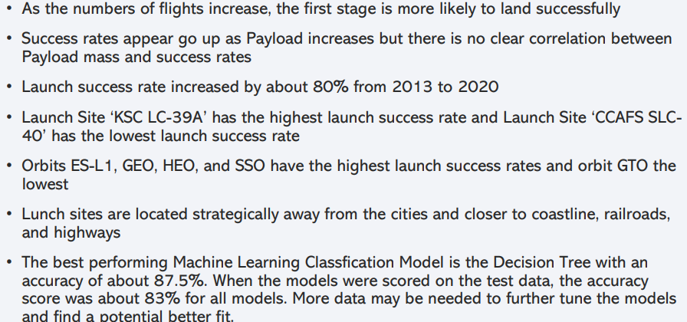
Conclusions

Slide 47


